Slide 1
Tuples in Python
An Introduction to Python Data Structures

Slide 2

What is a Tuple?
A tuple is a collection of ordered and immutable elements in Python.
Tuples are similar to lists, but they cannot be changed (immutable).

Slide 3
Characteristics of Tuples
Ordered: Tuples maintain the order of elements.
Immutable: Once defined, tuple elements cannot be changed.
Allows Duplicates: Tuples can contain duplicate elements.
Mixed Data Types: Tuples can hold different types of data in a single collection.
Indexing and Slicing: You can access tuple elements using indices and slices.

Slide 4
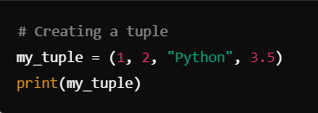
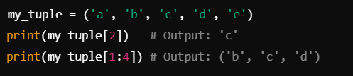
Creating Tuples
Example:
Tuple Indexing and Slicing :
Indexing starts at 0, and slicing can retrieve a range of elements.

Slide 5

Nested Tuples
Tuples can be nested, meaning one tuple can be an element of another tuple.

Slide 6

Immutability of Tuples
Tuples cannot be modified once created. Any attempt to change an element will result in an error.

Slide 7
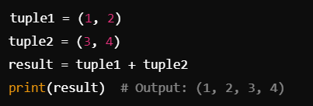

Tuple Operations
Tuple Concatenation
Tuple Multiplication

Slide 8
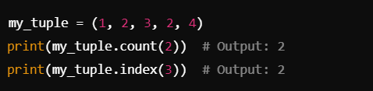
Tuple Methods
count(): Returns the number of times an element appears in a tuple.
index(): Returns the index of the first occurrence of an element.

Slide 9
Why Use Tuples?
Tuples are more memory-efficient than lists.
Useful for fixed data that shouldn't change during program execution.
Tuples can be used as dictionary keys (while lists cannot).
Protects data from accidental modification.

Slide 10
THANK YOU
HAPPY LEARNING!

